Slide 1
Actor-Hybrid-Attention-Critic for Multi-Logistic Robots Path Planning
by Chunjie Yang, Bodi Yuan, and Pengzhao Zhai.
Submitted by: Shaked Ozer & Shahar Cohen
Notes:
Hi, so today we are going to talk about the algorithm presented in the paper
Actor Hybrid Attention Critic for Multi Logistic Robots Path Planning.

Slide 2
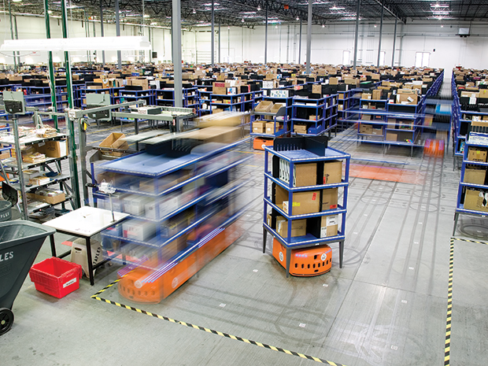
Introduction & Motivation
Growth of express delivery (e.g., over 110 Billion packages in China, 2022).
Rise of multi-logistic robots (like Amazon’s Kiva).
Challenges:
Complex, dynamic environments.
Collision avoidance and energy constraints.
Efficient, scalable decision-making for many robots.
Notes:
In our days, there is a growth of express delivery. In China, in 2022, there were over 110 billion packages!
The rise in warehouses using multi-logistic robots, such as Amazon’s Kiva, as you can see in this image, raises some challenges:
They have to be efficient, to work in a changing, dynamic environment, and on top of all, to avoid collisions.

Slide 3
MAHAC
Multi Actor Hybrid Attention Critic
Notes:
The suggested algorithm in this paper is MAHAC, which stands for Multi-Actor Hybrid Attention Critic. It’s a deep reinforcement learning method for multi-robot path planning. It builds on the MAAC algorithm but improves it by adding a hybrid attention mechanism, which helps each robot focus on the most important information from the environment and from other robots. This leads to better decisions — faster, safer, and more efficient. Unlike MAAC, which uses a separate attention head for each robot, MAHAC uses a small number of shared heads for all robots. That makes it much more scalable when there are lots of agents.

Slide 4
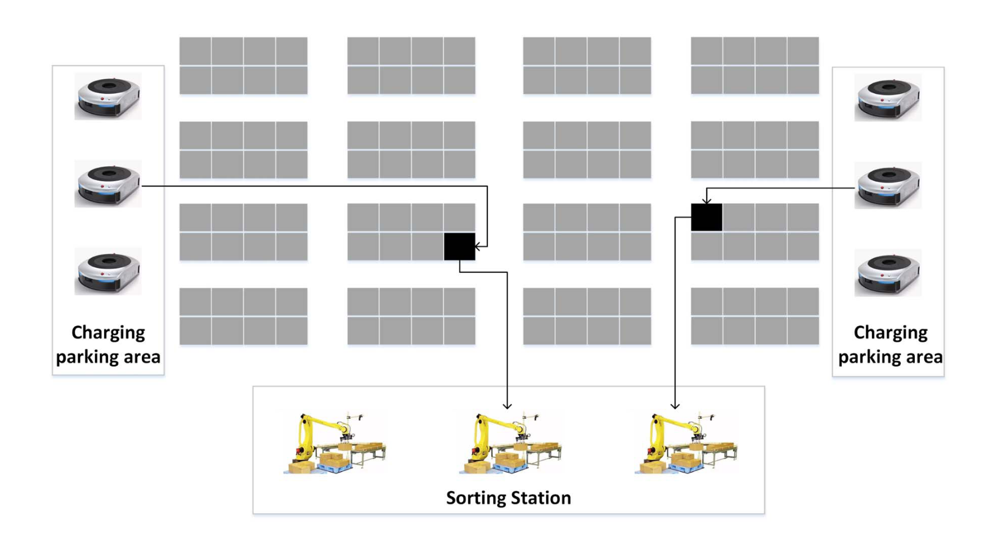
Modeling the Logistics Environment
Problem Setup
Notes:
The general idea of this kind of warehouse is that a robot starts from the charging parking area and carries the assigned task shelf to the target sorting table. Its goal is to find an optimal path from the charging parking area to the task shelf, and then to the target sorting table, in the least time, with the highest accuracy and no collisions.

Slide 5
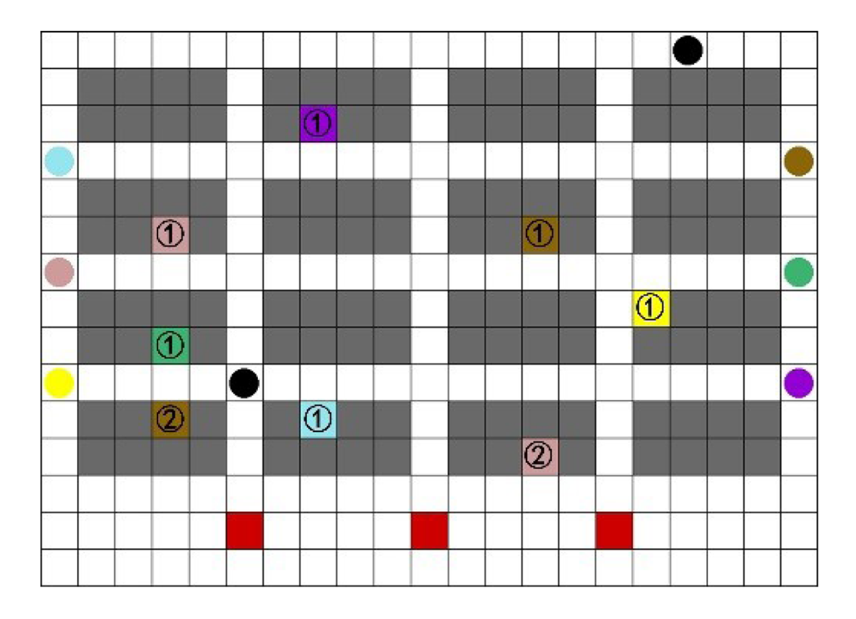
Modeling the Logistics Environment
S – Environmental State Space
O – Observation State Space
A – Action Space
Problem Setup
Environmental State Space
Notes:
To train and simulate the behavior of logistic robots, we first define the environment as a Partially Observable Markov Decision Process, or POMDP.
On the left, we see the high-level problem setup,
To implement this in a simulation, we convert this layout into a discrete grid-based representation, shown on the right. Each cell in the grid represents a unit of space in the warehouse:
Gray squares are static shelves
Colored circles are robots
Red squares are sorting stations
Black circles represent dynamic obstacles like moving workers
Numbered colored tiles represent the task shelves assigned to each robot; those are not assigned in an optimized way, since this is not the goal of the paper.
This grid becomes our Environmental State Space (S) — it encodes the full state of the environment at any given time. However, individual robots only observe part of this state — their local surroundings, which is what we define as the Observation Space (O).
Finally, each robot chooses actions from a limited Action Space (A) — such as moving in one of four directions or staying still — based only on its local observation.
So, here we are introduced to not just the architecture, but also the transformation from the conceptual logistics setup into a structured, grid-based simulation environment.

Slide 6
Environmental State Space (S)
Notes:
Robot movement is defined on a 2D grid with the origin at the top-left, the x-axis pointing down, and the y-axis to the right.
The environmental state space is a set of all possible true states of the environment.
This includes complete information about everything relevant to the system: positions of all robots, obstacles, battery levels, etc.

Slide 7
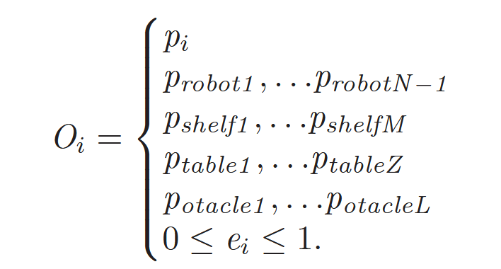
Observed State Space (O)
Notes:
Each robot, the colored circles on the left and right of the grid, observes its own position, the relative positions of other robots, task shelves, sorting tables, and static obstacles around it, as well as its current battery level.

Slide 8
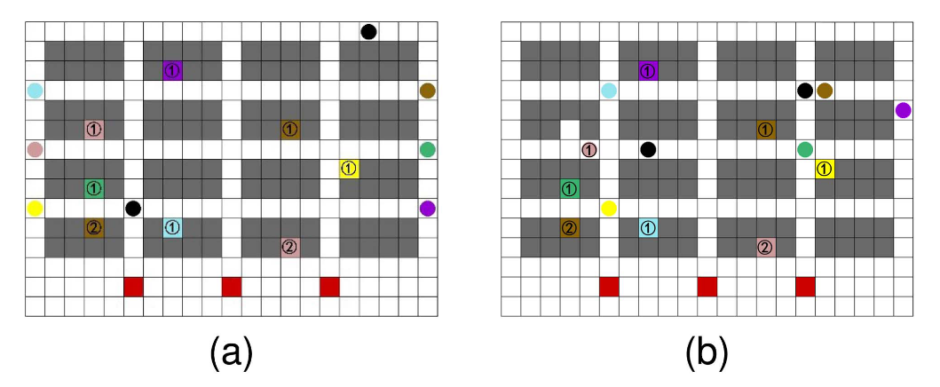
Action space (A)
Notes:
In the Action Space we have Five actions: up, down, left, right, stay.

Slide 9
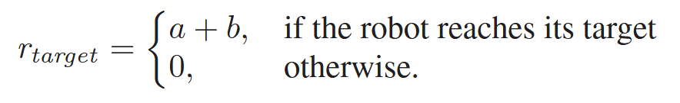
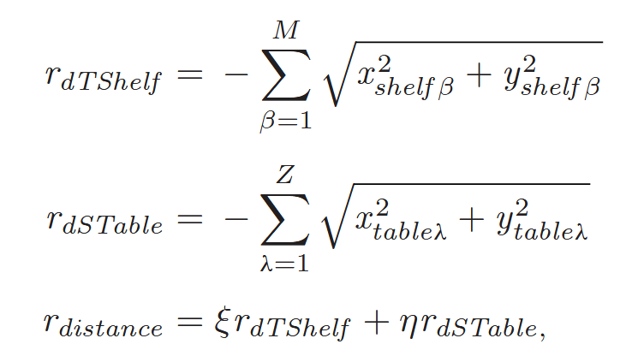
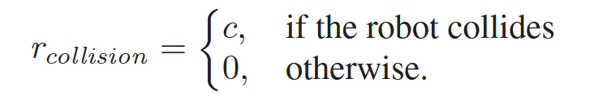

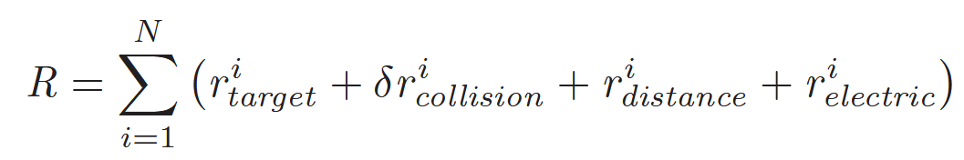
Reward Function
Notes:
The reward function in MAHAC is designed to guide the robot toward efficient, collision-free task completion. It includes:
Positive rewards are given when the robot reaches its assigned shelf and delivers it to the sorting table.
Penalties for collisions with robots, workers, obstacles, or warehouse walls.
Sparse penalties based on the robot’s distance from the current target (either the shelf or sorting table), encouraging progress.
Low battery penalty if power drops below 10%, encouraging robots to stay charged.
The final reward balances task success with safety and energy efficiency, ensuring smarter path planning.

Slide 10
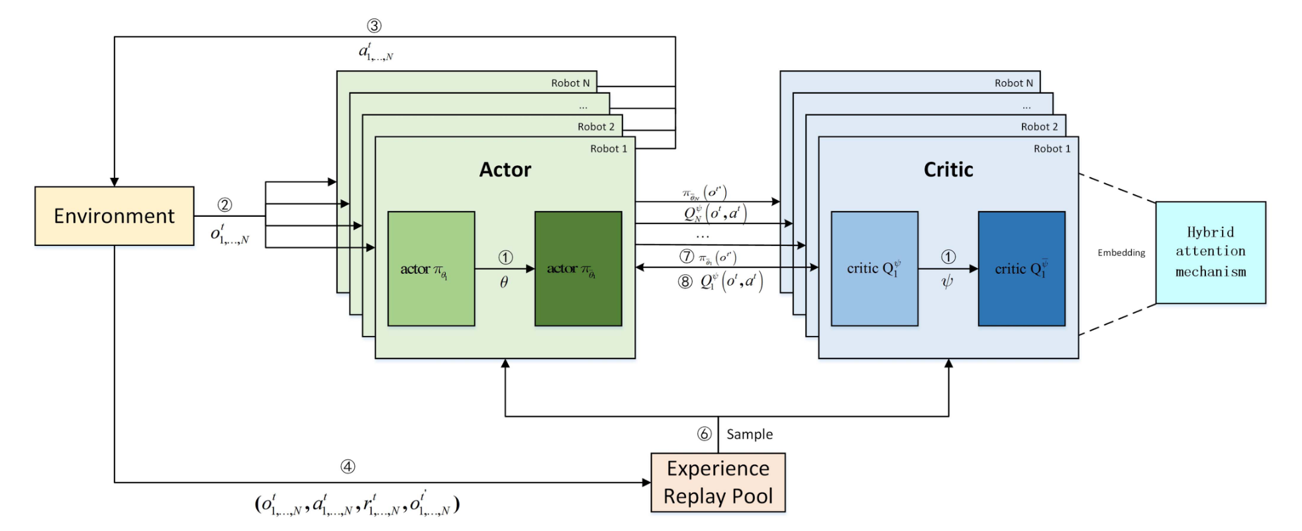
Notes:
This diagram shows how MAHAC works behind the scenes. Each robot has its own actor and critic. The actor decides what to do based only on what the robot can see. The critic, on the other hand, sees everything — all robots’ observations and actions — and helps train better decisions.
Here’s how training happens:
The robot observes, acts, and gets a reward from the environment.
That experience is saved in memory.
Later, we sample from that memory to train the networks.
The critic is updated first, then the actor learns from it.
The target networks are slowly updated to keep things stable.
What makes MAHAC special is that the critic uses a hybrid attention mechanism — it helps the robot focus on the most important things, like nearby robots or obstacles, instead of treating everything equally.

Slide 11
Simulation Setup
Simulated warehouse similar to Amazon’s Kiva system.
Grid layout: 15x21.
Includes shelves, sorting tables, workers, and 6–10 robots.
Tuning the number of Attention Heads.
Notes:
Our simulation environment is based on a 15 by 21 grid warehouse layout inspired by Amazon’s Kiva system. It includes static shelves, sorting tables, dynamic workers, and between 6 to 10 robots per run. One key hyperparameter they experimented with is the number of attention heads in the hybrid attention mechanism.
They tested several values and found that 4 heads yielded the best performance, balancing information extraction and computational cost.

Slide 12
Programming Structure
Environmental function
Actor-critic function
Reward function
Main function
Notes:
The programming of this algorithm was done in Python.
It has four main functions: Environmental function – to create a field of “play”, and calculate the state space and observation space.
An actor-critic function to manage the actor-critic using a policy function and DRL methods to dictate the actions’ states probabilities.
A reward function – to implement the reward that was discussed before.
And the main function, who is in charge of the number of iterations at every training and connects everything.

Slide 13
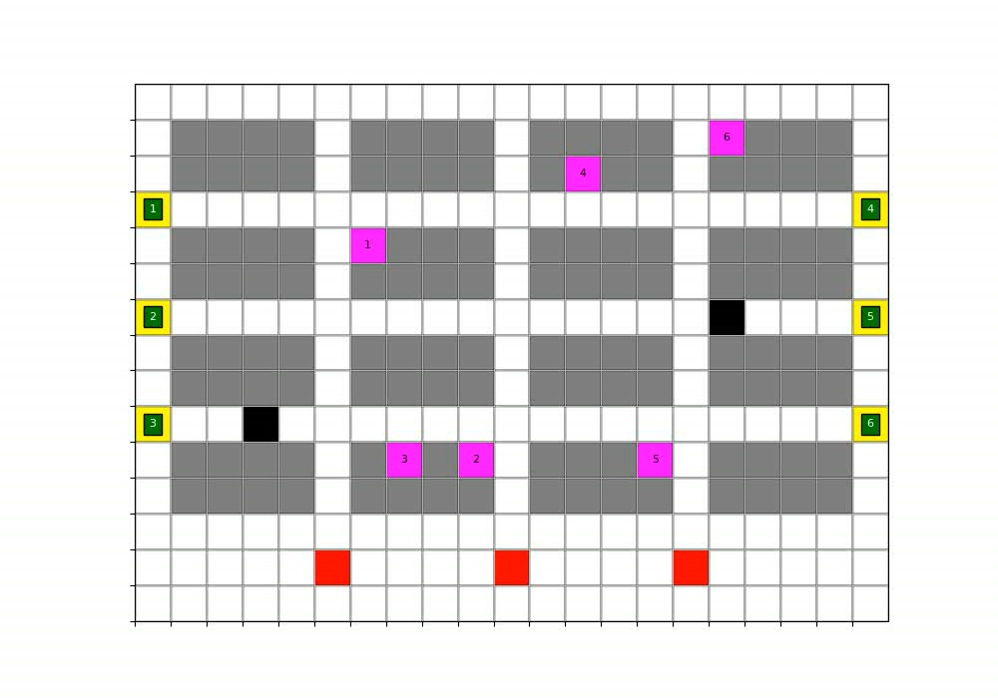
Simulation Visualization
Notes:
Robots plan, pick, deliver, and return shelves.
Smooth traffic, collision-free.

Slide 14
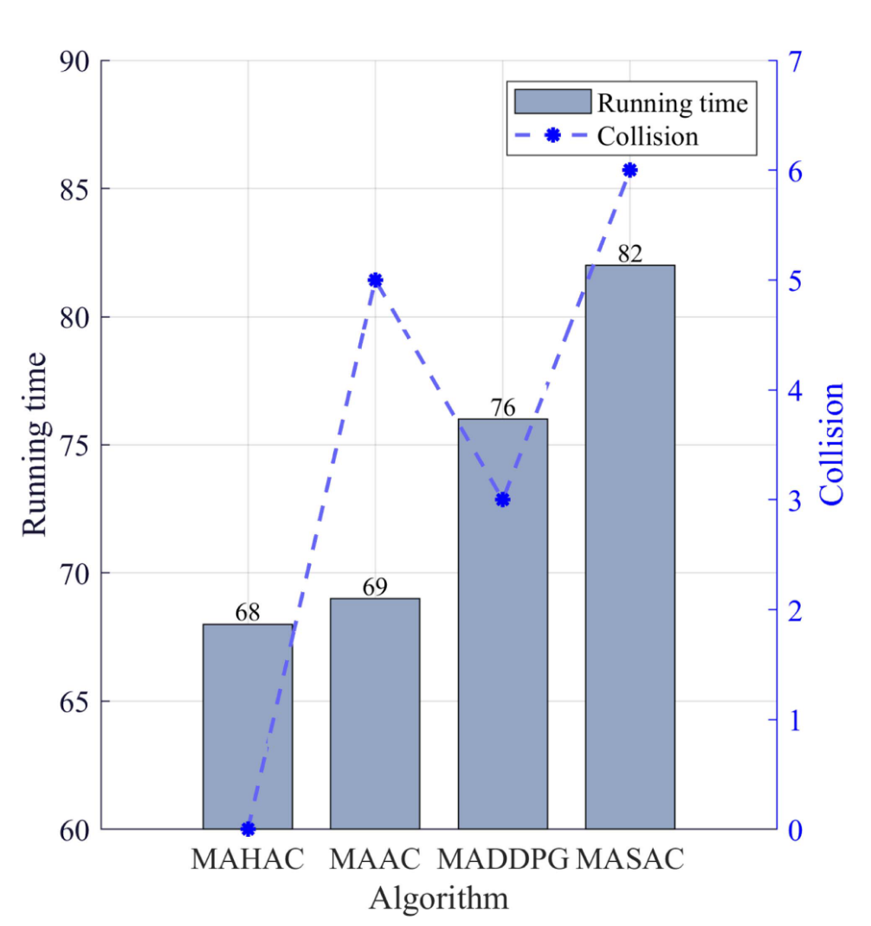
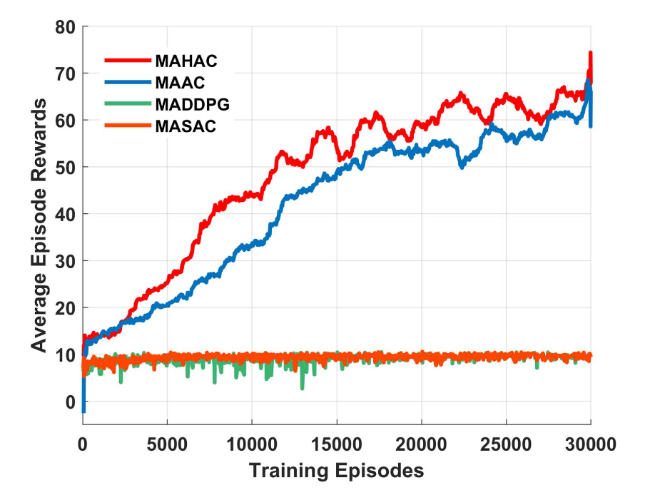
Results
Notes:
Here we can see, by the results from the paper, how MAHAC compares to other algorithms in both training and performance.
On the left, we see the average reward over 30,000 training episodes. MAHAC, in red, learns faster and achieves the highest reward overall. MAAC, in blue, performs well but stays below MAHAC. MADDPG and MASAC barely improve — they stay near the bottom, showing poor learning.
On the right, we compare running time and the number of collisions. MAHAC not only finishes tasks faster than the others — it also has zero collisions, which means it’s both efficient and safe. MAAC takes a bit longer and has collisions, while the two other algorithms perform worse on both fronts.
So overall, MAHAC clearly outperforms the other methods in terms of speed, safety, and learning quality.

Slide 15
Pros and Cons
Pros | Cons/Challenges
Better attention to important features | Needs centralized critic (offline only)
Robust with many robots | More complex than standard DRL
Adaptable to dynamic tasks | MLP-based attention increases compute
Outperforms MAAC, MADDPG, MASAC | Assumes homogeneous robot capabilities
Notes:
To evaluate MAHAC as a practical solution for multi-robot logistics, we looked at both its strengths and limitations.
On the pros side:
The hybrid attention mechanism allows agents to focus better on important state-action features, improving decision quality.
It’s robust even as the number of robots increases, showing strong scalability.
It’s adaptable to dynamic tasks, such as changing obstacle locations or task shelves mid-run.
And overall, it outperforms previous approaches like MAAC, MADDPG, and MASAC in terms of reward, efficiency, and collision avoidance.
On the challenges side:
MAHAC relies on a centralized critic during training, so it’s not purely decentralized — execution is, but training isn’t.
It’s more complex than standard DRL methods, requiring more tuning and architectural design.
The use of an MLP inside the attention mechanism increases computational cost.
And the current implementation assumes that all robots are functionally identical, which could limit generalization in heterogeneous fleets.
In short, MAHAC delivers meaningful performance improvements, but like many powerful models, it comes with trade-offs in complexity and scalability.

Slide 16

Conclusions
MAHAC is an effective, scalable path planning method for multi-robot warehouses.
Hybrid attention significantly boosts performance.
Demonstrated success in realistic simulations.
Notes:
To summarize, the MAHAC algorithm was implemented and validated through simulation.
Results: Achieved best performance in reward, time, and safety metrics compared to other algorithms.
Pros: High scalability, decentralized execution, adaptive decision-making.
Cons: Increased training complexity, reliance on accurate sensors.
Recommendations: Explore real-world deployment, incorporate dynamic task allocation, and multi-modal sensor fusion.

